Slide 1
Chapter Two :Process Management
A key concept in all operating systems is the process. A process is a program in execution or a process is defined as an entity which represents the basic unit of work to be implemented in the system and a program that is loaded into memory and is executing is commonly referred to as a process.
Associated with each process is its address space, a list of memory locations from 0 to some maximum, which the process can read and write.
The address space contains the executable program, the program's data, and its stack.
Also associated with each process is a set of resources, commonly including registers (including the program counter and stack pointer).

Slide 2
Cont…
Program Counter: This register is used to sequence the execution of the instructions. The function of the program counter is to point to the memory address from which the next byte is to be fetched.
Stack Pointer: It is used as a memory pointer. It points to a memory location in read/write memory, called the stack.
In many operating systems, all the information about each process, other than the contents of its own address space, is stored in an operating system table called the process table, which is an array (or linked list) of structures, one for each process currently in existence.

Slide 3
Cont…
If a process can create one or more other processes (referred to as child processes) and these processes in turn can create child processes, we quickly arrive at the process tree structure of.
Related processes that are cooperating to get some job done often need to communicate with one another and synchronize their activities. This communication is called inter-process communication.

Slide 4
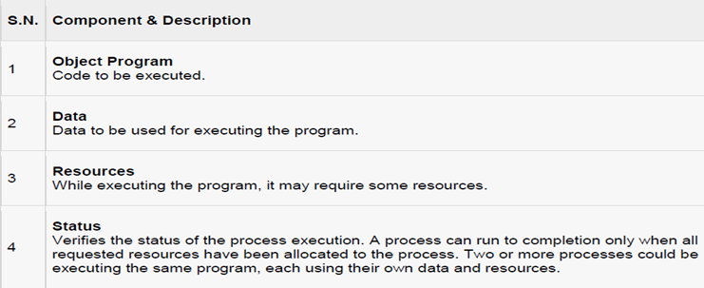
Components of a process

Slide 5
Program vs Process
A program by itself is not a process. It is a static entity made up of program statement while process is a dynamic entity.
Program contains the instructions to be executed by processor.
A program takes a space in memory and continues to stay there and program does not perform any action by itself.
The major difference between program and process is that program is a group of instructions to carry out a specified task whereas the process is a program in execution.
While a process is an active entity, a program is considered to be a passive one.
one program can invoke multiple processes or in other words multiple processes can be a part of the same program.

Slide 6
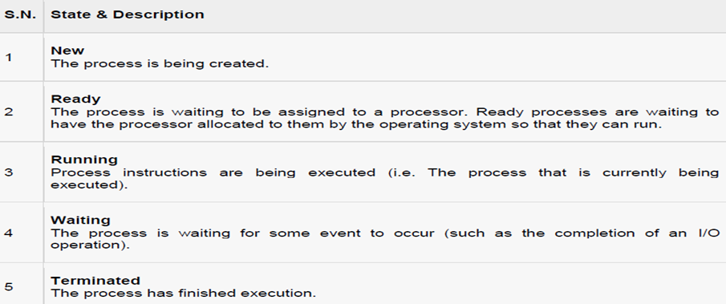
Process States
As a process executes, it changes state. The state of a process is defined as the current activity of the process. Process can have one of the following five states at a time.

Slide 7
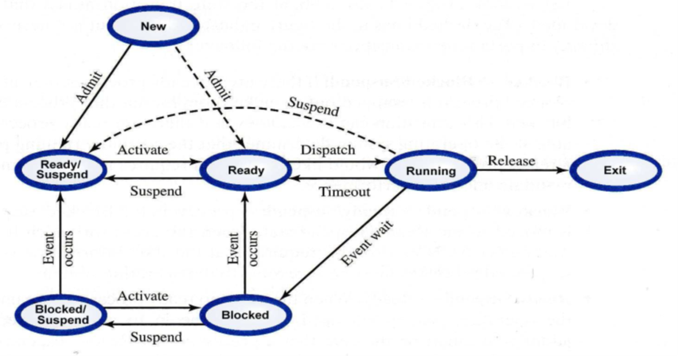
Cont…

Slide 8
Cont…
Ready: The process is in main memory and available for execution.
Blocked: The process is in main memory and awaiting an event.
Blocked/Suspend: The process is in secondary memory and awaiting an event.
Ready/Suspend: The process is in secondary memory but is available for execution as soon as it is loaded into main memory.

Slide 9
Characteristics of suspend process
Suspended process is not immediately available for execution.
The process may or may not be waiting on an event.
For preventing the execution, process is suspend by OS, parent process, process itself and an agent.
Process may not be removed from the suspended state until the agent orders the removal.
Swapping is used to move all of a process from main memory to disk. When all the process by putting it in the suspended state and transferring it to disk.

Slide 10
Reasons for process suspension
Swapping: OS needs to release required main memory to bring in a process that is ready to execute.
Timing: Process may be suspended while waiting for the next time interval.
Interactive user request: Process may be suspended for debugging purpose by user.
Parent process request: To modify the suspended process or to coordinate the activity of various descendants.

Slide 11
Process Control Block, PCB
Whenever processes changes state, the operating system reacts by placing the process PCB in the list that corresponds to its new state.
Only one process can be running on any processor at any instant and many processes may be ready and waiting state.
Each process is represented in the operating system by a process control block (PCB) also called a task control block.
PCB is the data structure used by the operating system. Operating system groups all information that needs about particular process.

Slide 12
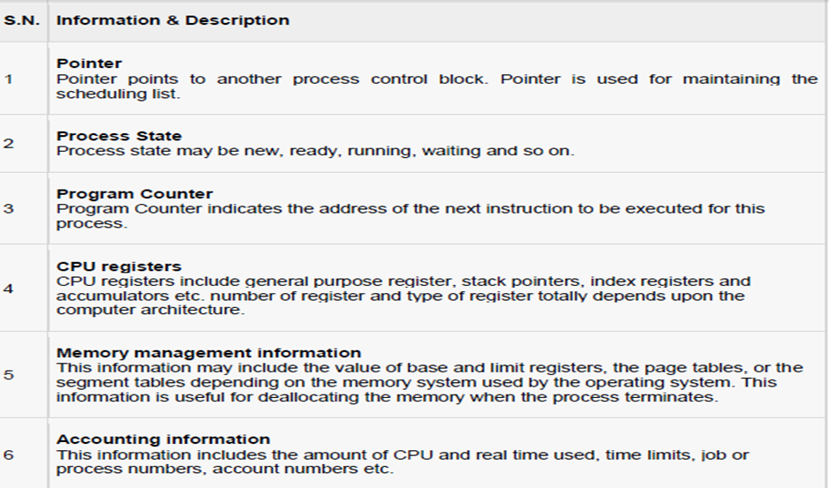
PCB contains many pieces of information associated with a specific process

Slide 13
Thread vs. Process
A thread is a dispatch able unit of work (lightweight process) that has independent context, state and stack.
A process is a collection of one or more threads and associated system resources.
Traditional operating systems are single-threaded systems and Modern operating systems are multithreaded systems.
Multithreading is a technique in which a process, executing an application, is divided into threads that can run concurrently.
All threads share the same address space and a separate thread table is needed to manage the threads

Slide 14
Threads can be managed in the kernel or user space
Kernel Space:-
The operating system is aware of the existence of multiple threads
When a thread blocks, the operating system chooses the next one to run, either from the same process or a different one
The kernel has a thread table
Thread management is slow
User Space:-
The operating system is not aware of the existence of multiple threads
When a thread is about to block, it chooses and starts its successor before stopping.
The user space has a thread table
Thread management is much faster (specially switching)
When one thread blocks, the kernel blocks the entire process
Both systems are in use and various hybrid schemes have been proposed as well

Slide 15
Inter-Process Communication, Concurrency and Its Problems
The most fundamental task of modern operating systems is management of multiple processes within uniprocessor, multiprocessor or distributed computer systems.
The fundamental design issue in the management of multiple processes is concurrency: simultaneous execution of multiple processes.
Concurrency arises in three different contexts
Multiple applications: concurrently running applications
Structured applications: an application structured as a set of concurrent processes (threads)

Slide 16
Inter-process Communication
There is frequent interaction among concurrently running processes. There are three ways in which concurrent processes interact with each other:
Competition for Resources
Cooperation by Sharing Resources
Cooperation by Communication

Slide 17
Competition for Resources
It occurs when independent processes that are not intended to work together compete for the use of the same or shared resource, e.g. printer, memory, or file
There is no exchange of information between competing processes
Processes are unaware of each other

Slide 18
Cooperation by Sharing Resources
It occurs when processes that are not necessarily aware of each other use and update shared data without reference to other processes but know that other processes may have access to the same data
Processes must cooperate to ensure that the data they share are properly managed
Processes are aware of each other indirectly

Slide 19
Cooperation by Communication
It occurs when various processes communicate with each other, for instance with message passing in order to provide a way to synchronize or coordinate their various activities.
There is nothing shared between processes
Processes are aware of each other directly

Slide 20
Concurrency Problems:-Race Condition
A situation that occurs when two or more processes are reading or writing into some shared data and the final result depends on who runs precisely when.
E.g. Printer Spooler: when a process wants to print a file, it enters the file name in a special spooler directory.
There are two globally shared variables
Outfile: points to the next file to be printed
Infile: points to the next free slot in the directory

Slide 21
Cont…
There are some files in the spooler directory and assume the current value of infile is 7 and that of outfile is 3
Assume that simultaneously process A and process B decide they want to queue a file for printing
Process A reads infile and stores the value 7 in its local variable (x=infile)
An interrupt occurs and the CPU decides that process A has run long enough so it switches to process B
Process B reads infile and stores the value 7 in its local variable (y=infile)
Process B stores the name of its file in slot 7 and adjusts infile to be 8
Eventually process A runs again, it checks x and finds 7 there, and writes its file name in slot 7, erasing the name process B just put there, it updates infile to be 8
The printer daemon will now print the file of process A, process B file will never get any output.

Slide 22
b.Deadlock
A set of blocked processes each holding a resource and waiting to acquire a resource held by another process in the set.
It is the permanent blocking of a set of processes that either compete for system resources or communicate with each other.
It refers to a situation in which a set of two or more processes are waiting for other members of the set to complete an operation in order to proceed, but none of the members is able to proceed.
A deadlock is a condition wherein two or more tasks are waiting for each other in order to be finished but none of the task is willing to give up the resources that other task needs.
In this situation no task ever gets finished and is in waiting state forever.
Process P1 holds resource R2 and require R1 while process P2 holds resource R1 and require R2.

Slide 23
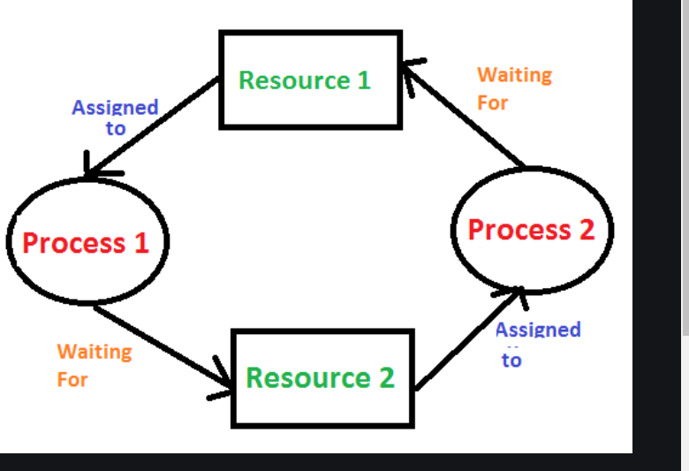
Cont…

Slide 24
Deadlock Characterization
Mutual exclusion: only one process at a time can use a resource.
Hold and wait: a process holding at least one resource is waiting to acquire additional resources held by other processes.
No pre-emption: a resource can be released only voluntarily by the process holding it, after that process has completed its task.
Circular wait: there exists a set {P0, P1, …, Pn} of waiting processes such that P0 is waiting for a resource that is held by P1, P1 is waiting for a resource that is held by P2, …, Pn–1 is waiting for a resource that is held by Pn.

Slide 25
Deadlock Prevention
Mutual Exclusion – not required for sharable resources; must hold for non-sharable resources.
Hold and Wait – must guarantee that whenever a process requests a resource, it does not hold any other resources."
Require process to request and be allocated all its resources before it begins execution, or allow process to request resources only when the process has none.
Low resource utilization; starvation possible."
No Pre-emption
If a process that is holding some resources requests another resource that cannot be immediately allocated to it, then all resources currently being held are released."
Pre-empted resources are added to the list of resources for which the process is waiting."
Process will be restarted only when it can regain its old resources, as well as the new ones that it is requesting.
Circular Wait – impose a total ordering of all resource types, and require that each process requests resources in an increasing order of enumeration."

Slide 26
c. Starvation
It refers to the situation in which a process is ready to execute but is continuously denied access to a processor in deference to other processes.
E.g. suppose that there are three processes P1, P2, and P3 and each require periodic access to resource R.
If the operating system grants the resource to P1 and P2 alternately, P3 may indefinitely be denied access to the resource, thus starvation may occur.

Slide 27
D. Mutual Exclusion
The key to preventing race condition is to enforce mutual exclusion: It is the ability to exclude (prohibit) all other processes from using a shared variable or file while one process is using it.
Part of a program where shared resource (critical resource) is accessed is called critical region or critical section
The fundamental strategy for implementing mutual exclusion is avoiding the situation where no two processes could ever be in their critical regions at the same time.

Slide 28
There are some basic requirements that should be met while implementing mutual exclusion.
1. No two processes may be simultaneously in their critical regions
2. No assumptions may be made about speed or the number of processors
3. No process running outside its critical region may block other processes
4. No process should have to wait forever to enter its critical region

Slide 29
Processor Scheduling (CPU Scheduling)
Processes are managed through the use of multiple queues (or lists) of PCB's; the word queue (in an OS queue contains all jobs submitted to the system, but not yet in main memory the ready queue contains all jobs in main memory ready to execute.
Each I/O device has a queue of jobs waiting for various I/O operations
A process is dispatched from the ready queue to the CPU; its processing may cause it to be put on a device queue.

Slide 30
Processor Scheduling
Processor Scheduling is the means by which operating systems allocate processor time for processes.
It can be implemented on uniprocessor systems (Uniprocessor Scheduling), Multiprocessor systems (Multiprocessor Scheduling), Real-time systems (Real-time Scheduling)
The operating system makes three types of scheduling decisions with respect to execution of processes:

Slide 31
i.Long-term Scheduling
The decision to add to the pool of processes to be executed
It determines when new processes are admitted to the system
It is performed when a new process is created and admitted
a. New → Ready
b. Blocked/Suspend → Ready/Suspend

Slide 32
ii.Medium-term Scheduling
The decision to add to the number of processes that are partially/fully in main memory
It determines when a program is brought partially or fully into main memory so that it may be executed
It is performed when swapping is done
a. Ready/Suspend →Ready
b. Blocked/Suspend → Blocked

Slide 33
iii. Short-term Scheduling
The decision of which ready process to execute next
It determines which ready process will get processor time next
It is performed when a ready process is allocated the processor (when it is dispatched)
Ready → Running
Part of the operating system that makes scheduling decision is called scheduler and the algorithm it uses is called scheduling algorithm.
In the case of short term scheduling, the module that gives control of CPU to the process selected by the scheduler is called dispatcher.

Slide 34
Requirements that should be met by short-term scheduling algorithms.
Response Time: The time from submission of request until the response begins to be received. it should be minimized
Turn Around Time: For batch users, the interval of time between the submission of a process and its completion should be minimized (Completion Time-Start Time)
Throughput: The number of processes completed per unit time (jobs / second). it should be maximized
Efficiency/CPU Utilization: The percentage of time that the CPU is busy should be maximized
Dispatch latency – time it takes for the dispatcher to stop one process and start another running.
Waiting time – sum of the periods spent waiting in the ready queue.
Service time -The time required by a device to handle a request. (seconds)
Queuing time -Time on a queue waiting for service from the device. (seconds)
Residence time- The time spent by a request at a device.
Residence time = service time + queuing time.

Slide 35
Generally to optimize the execution time
Max throughput
Min turnaround time
Min waiting time
Min response time

Slide 36
Two main characteristics of short-term scheduling algorithms
1.Selection function
It determines which process, among ready processes, is selected for execution.
It may be based on
­Priority
­Resource requirement
­Execution behavior: time spent in system so far (waiting and executing), total service time required by the process

Slide 37
2.Decision mode
It specifies the instants in time at which the selection function is exercised
There are two types of decision modes
i.­Preemptive
The strategy of allowing processes that are logically runnable to be temporarily suspended and be moved to the ready state.
Events that may result pre-emption are arrival of new processes, occurrence of an interrupt that moves blocked process to ready state and clock interrupt
Suitable for general purpose systems with multiple users
Guarantees acceptable response time and fairness
Context switching is an overhead

Slide 38
­ ii. Non-Preemptive
Run to completion method: once a process is in running state, it continues to execute until it terminates or blocks itself to wait for some event
Simple and easy to implement
Used in early batch systems
It may be well reasonable for some dedicated systems
Efficiency can be attained but response time is very high

Slide 39
CPU scheduling decisions may take place when a process:
1. Switches from running to waiting state (ex., I/O request).
2. Switches from running to ready state (ex., Interrupts occur).
3. Switches from waiting to ready state (ex., Completion of I/O).
4. Terminates.
Under nonpreemptive scheduling, once the CPU has been allocated to a process, the process keeps the CPU until it releases the CPU either by terminating or by switching to the waiting state.

Slide 40
Scheduling Algorithms (Short-term Scheduling Algorithms)
CPU scheduling deals with the problem of choosing a process from the ready queue to be executed by the CPU.
The following CPU scheduling algorithms will be described:
First-Come, First-Served (FCFS).
Shortest-Job-First (SJF).
Priority.
Round-Robin (RR).
Multilevel Queue.
Multilevel Feedback Queue.

Slide 41
A.First-Come, First-Served (FCFS) Scheduling
It is the simplest CPU scheduling algorithm.
The process that requests the CPU first is allocated the CPU first.
The average waiting time under FCFS is long.

Slide 42
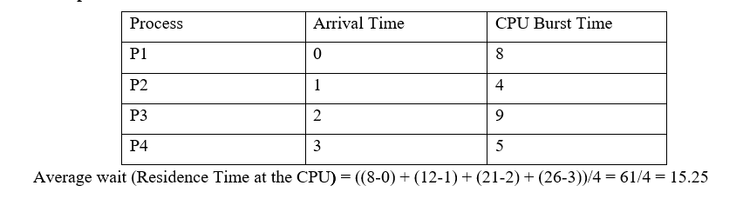
Example 1

Slide 43
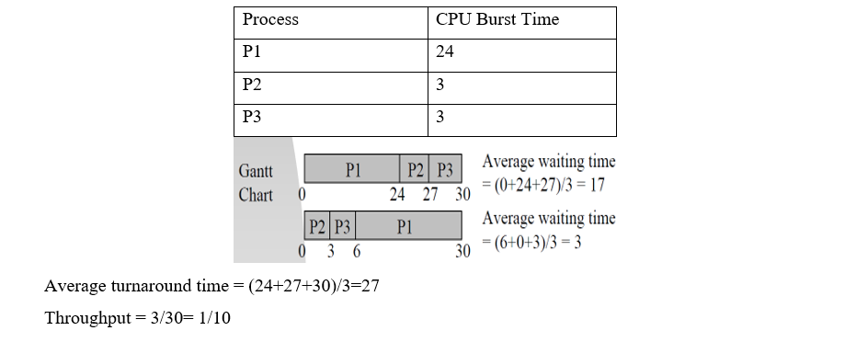
Example 2:

Slide 44
B.Shortest Job First Scheduling (SJFS)
Process with the shortest expected processing time (CPU burst) is selected next.
Its selection function is execution time and it uses non preemptive scheduling/decision mode
Optimal for minimizing queuing time, but impossible to implement and it tries to predict the process to schedule based on previous history.
Associate with each process the length of its next CPU burst. Use these lengths to schedule the process with the shortest time.

Slide 45
Cont…
Non pre-emptive – once CPU given to the process it cannot be preempted until completes its CPU burst.
Preemptive – if a new process arrives with CPU burst length less than remaining time of current executing process, preempt.
This scheme is known as the Shortest-Remaining-Time-First (SRTF).
SJF is optimal – gives minimum average waiting time for a given set of processes.

Slide 46
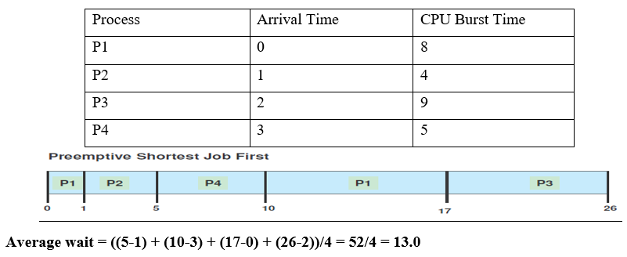
Example 1:

Slide 47
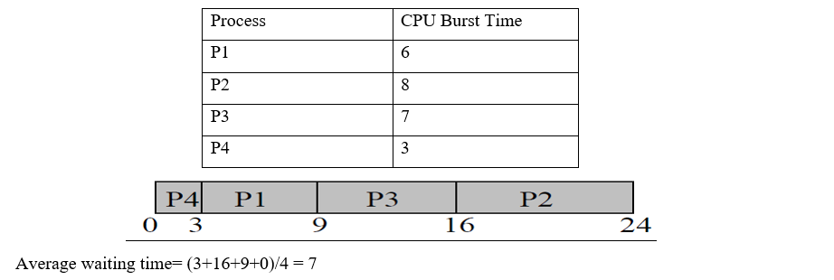
Example2:

Slide 48
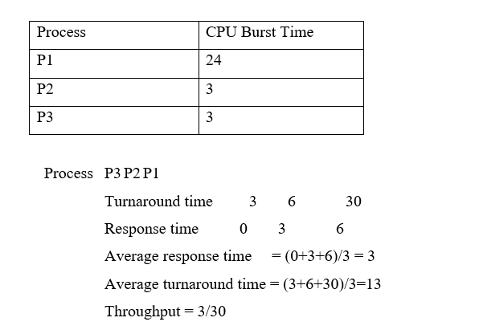
Example 3:

Slide 49
There are two schemes for SJF
Non pre-emptive – once CPU given to the process it cannot be pre-empted until completes its CPU burst.
Pre-emptive – if a new process arrives with CPU burst length less than remaining time of current executing process, pre-empt.
This scheme is known as the Shortest-Remaining-Time-First (SRTF).

Slide 50
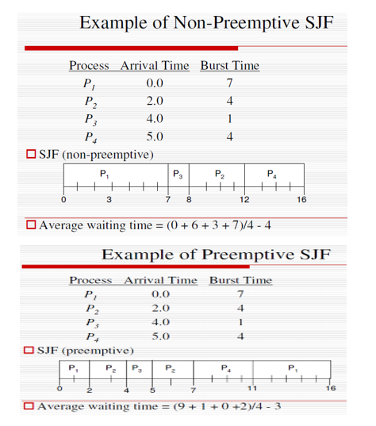
Cont…

Slide 51
C.Priority Scheduling
Assign each process a priority. Schedule highest priority first. All processes within same priority are FCFS.
Priority may be determined by user or by some default mechanism. The system may determine the priority based on memory requirements, time limits, or other resource usage.
Starvation occurs if a low priority process never runs. Solution: build aging into a variable priority (as time progresses increase the priority of the process).
A priority number (integer) is associated with each process
The CPU is allocated to the process with the highest priority (smallest integer ≡ highest priority).

Slide 52
Priority may be:
Pre-emptive: CPU scheduling is invoked whenever a process arrives at the ready queue, or the running process relinquishes the CPU.
Non preemptive: CPU scheduling is invoked only when the running process relinquishes the CPU.
SJF is a priority scheduling where priority is the predicted next CPU burst time.

Slide 53
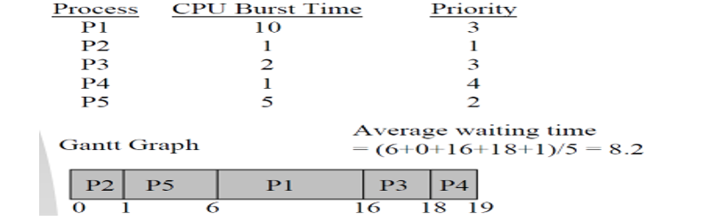
Example

Slide 54
Major Problem
Indefinite Blocking (/Starvation)
Low-priority processes could starve to death!

Slide 55
D.Round-Robin Scheduling (RR)
RR is similar to FCFS except that pre-emption is added to switch between processes and designed for time sharing systems.
Each process gets a small unit of CPU time (time quantum or time slice), usually 10-100 milliseconds. After this time has elapsed, the process is pre-empted and added to the end of the ready queue.
That is, after the time slice is expired an interrupt will occur and a context switch.

Slide 56
Choosing a time quantum
Too short - inordinate fraction of the time is spent in context switches.
Too long - reschedule latency is too great. If many processes want the CPU, then it's a long time before a particular process can get the
CPU. This then acts like FCFS.
Adjust so most processes won't use their slice. As processors have become faster, this is less of an issue.

Slide 57
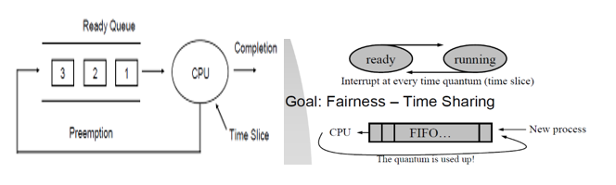
Cont…

Slide 58
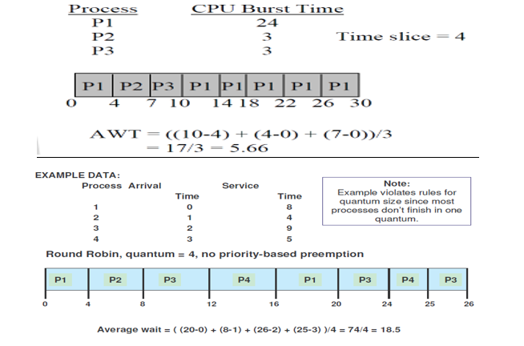
Example

Slide 59
Assignments
E. Multilevel Queue Scheduling
F. Multilevel Feedback Queue
Multiple-Processor Scheduling

Slide 60


